Slide 1


Python Fundamentals
Innovation Masters
Day 2

Slide 2
How is everyone doing?
You can share with the class anything new that you learnt.
The classroom is not a place where the teacher always speaks, and the students just listen. It's a place where individuals collectively enhance each other's intelligence by sharing their knowledge and experiences.
Best people to help you are your classmates.

Slide 3
Today’s Agenda
Meet and greet (done)
Small recap of last class
Learn about variables
Make programs together
Work on a program by yourself
End with tech discussion

Slide 4


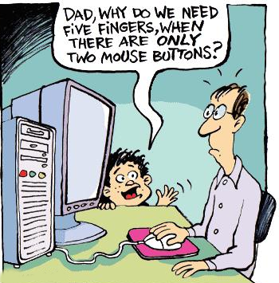
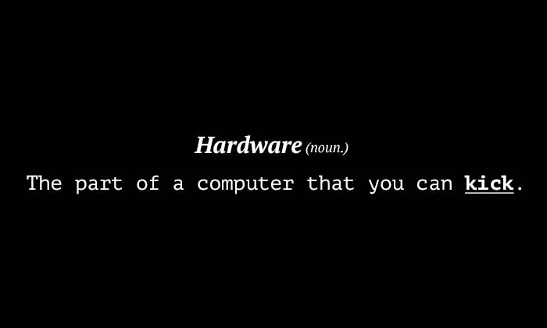
Previously in Python Fundamentals...
Software and Hardware
Programming Language?
Before Programming Languages?

Slide 5
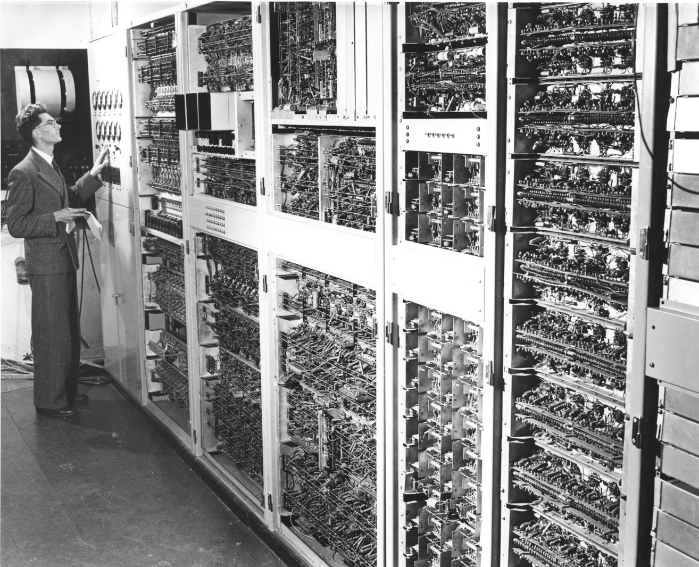
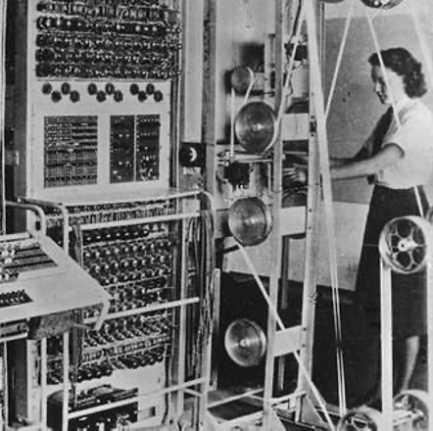
Before programming languages

Slide 6
Machine Language
Text: 0101010101010101010101000100011111
Numbers: 010000100010111110101101010110
Programs: 111010001011101001101010101001
Images: 00100010101110100100101010100010

Slide 7

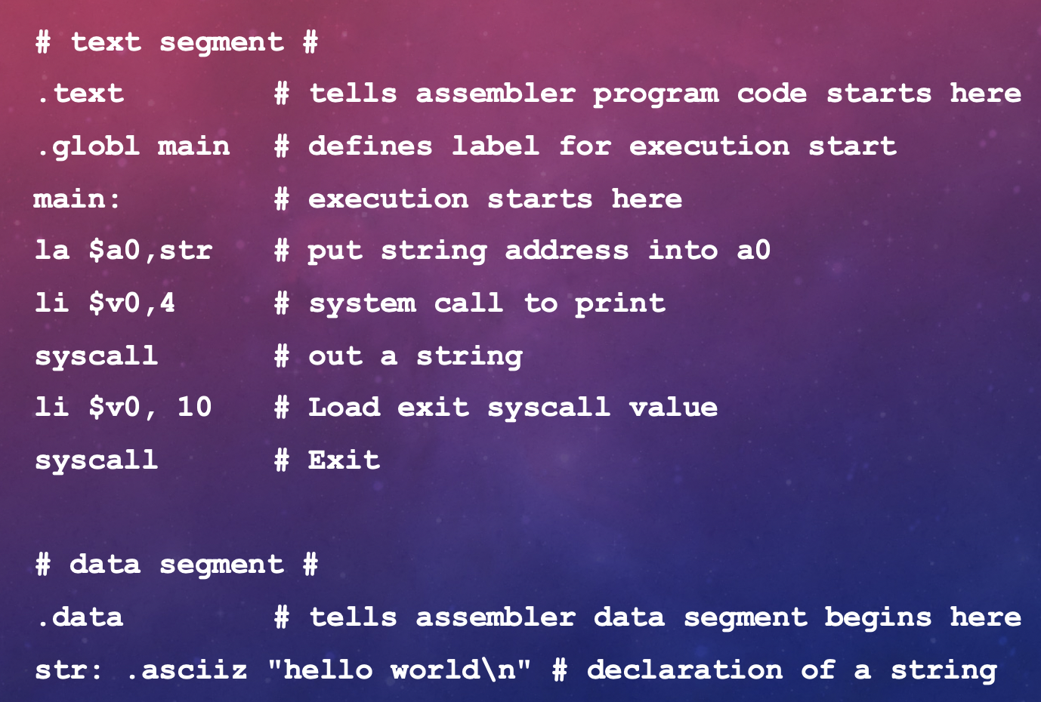



Assembly Language

Slide 8
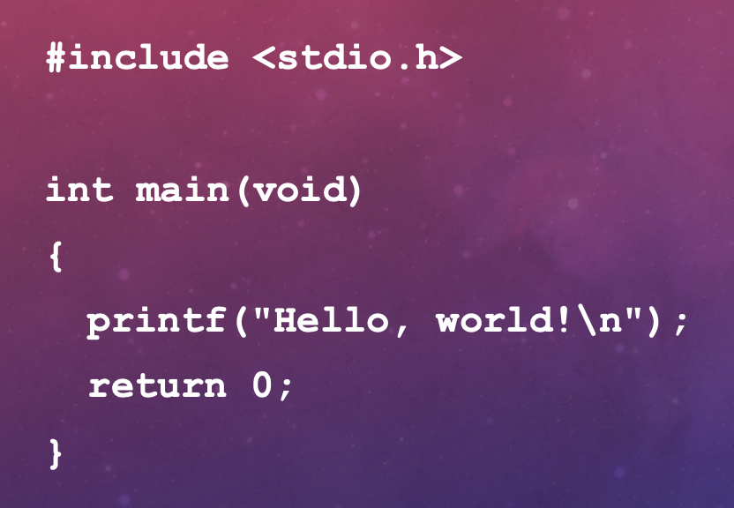
High Level Language

Slide 9
Let’s open Python now
Finally we ended the class by using the print command
What is the print command? It prints whatever’s inside the parentheses in the terminal.
If you want to print text, then put it inside “ ”
The terminal or command window is where we will see all output from computer and take input from user. This is where all the magic is happening.

Slide 10
Let us do a simple problem
We want to find the area of these shapes with listed dimensions:
Rectangle- length of 4 cm and width of 6 cm
Triangle- base of 3 cm and height of 6 cm
Volume of a cuboid- of your selected dimensions

Slide 11
Common Geometric formulas
Area:
Rectangle- L * W Triangle- ½ * B * H
Perimeter of a rectangle- 2L + 2W
Volume of cuboid- L * B * H
Surface Area of cuboid- 2LH +2LB+2HB

Slide 12
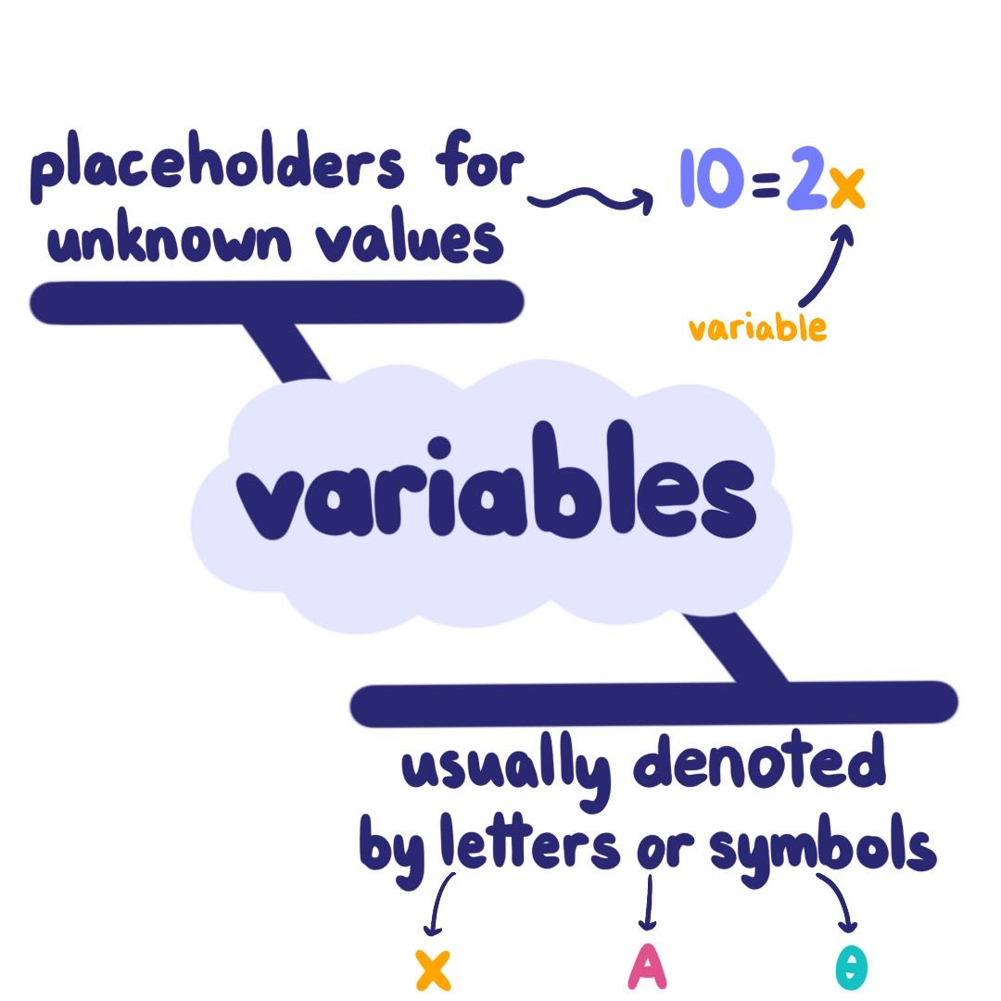
How can we generalize to have an equation?
We use variables.
Variables are any placeholders that hold some value or data.
They have 3 components:
Name
Data (something it holds)
Type (what kind of data it stores)

Slide 13
How to make/instantiate a variable
demoVariable = 5
Name Assign Data
Type will be discussed in later classes
Now you can repeatedly use this variable and modify its value.
Use variables in previous problem.

Slide 14
General Structure Of Making Any Program
Understand and define
Understand and define the problem
Determine
Determine the required input and output
Design
Design an algorithm to solve the problem by computer
Implement
Implement (code) the solution
Debug and test
Debug and test the software

Slide 15

Salary Calculator
Find the yearly salary of a person based on their wage per hour and how many hours they work every week.
Let’s apply the guideline discussed earlier
Annual Salary = wage/hour * hours/week * 52

Slide 16
Let’s take user input
Syntax
demoVariable = input(“Whatever you want to ask for: ”)
The value entered will be stored in the variable.
For our number inputs we use typecasting to turn String into integer.
Syntax
demoVariable = int(input(“Whatever you want to ask for: ”))
Now let’s use this in our salary calculator!

Slide 17
Time for your first program
Take input from user for length, width, and height of a cuboid.
Find the Surface Area and Volume of the cuboid and print the answers nicely with text.
Volume of cuboid- L * B * H
Surface Area- 2LH +2LB+2HB

Slide 18
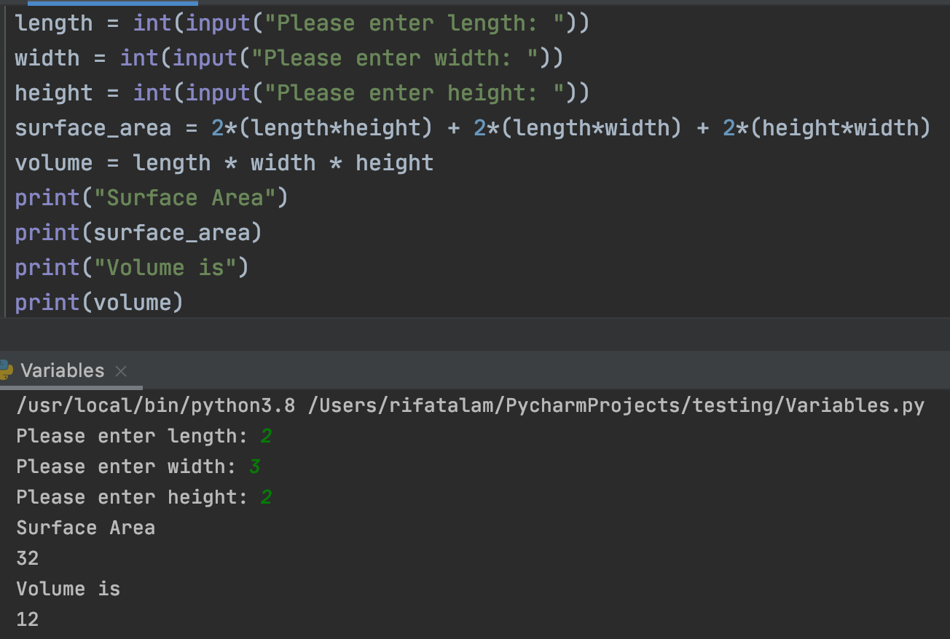



Solution

Slide 19
Homework
Profile Maker
Take user input for Name, Birth Year, Profession
Present it nicely
Demo
Name
Alex
Age
14
Profession
Student

Slide 20

Tech Talk

Slide 21
Adios
I’ll share google drive folder with all of you
Make sure to do the homework and if you need help email me
Shahrifat.Bhuiyan@gmail.com
Have fun and keep learning.
Have a great week and see you guys next class!

